Slide 1

REAL ESTATE SALES 2001 - 2020
Presented by: Adebowale Jesutola

Slide 2
Real Estate Sales 2001 - 2022
Table of Contents
Introduction
Objectives(What are we talking about?)
Story Telling(Data)
Recommendations
Conclusion

Slide 3
INTRODUCTION
This project is entails performing exploratory data analysis on Property Assessment and Sales data for Informed Decision-Making.
The Exploratory Data Analysis (EDA) for real estate sales involves analyzing and visualizing key aspects of real estate data to gain insights into market trends, property values, and sales patterns.
Main purpose is to analyzing the real estate sales data to extract valuable insights for stakeholders.

Slide 4

Objectives (What are we talking about?)

Slide 5
OBJECTIVES
Assessment Accuracy: Evaluate the accuracy of property assessments by comparing assessed values with actual sale amounts, and identify any discrepancies.
Market Trends: Analyze sales ratios to uncover trends in property market values, understanding how sale amounts relate to the assessed values across different property types and residential classifications.
Geographical Analysis: Investigate variations in assessed values, sales amounts, and market ratios across different towns, providing a localized understanding of real estate dynamics

Slide 6
OBJECTIVES continuation….
Property Type Impact: Examine the impact of property type on assessment accuracy and market trends, exploring whether certain types (e.g. residential, commercial) exhibit distinct pattern.
Non-Use Code Insights: Explore the significance of non-use codes in property assessment investigating how these codes influence assessed values and sales transactions.
Assessor and OPM Remarks: Analyze remarks provided by assessors and the Office of Polices and Management (OPM) to identify factors influencing assessment decisions and potential improvement areas.

Slide 7

Present Data Insights (Story Telling)

Slide 8
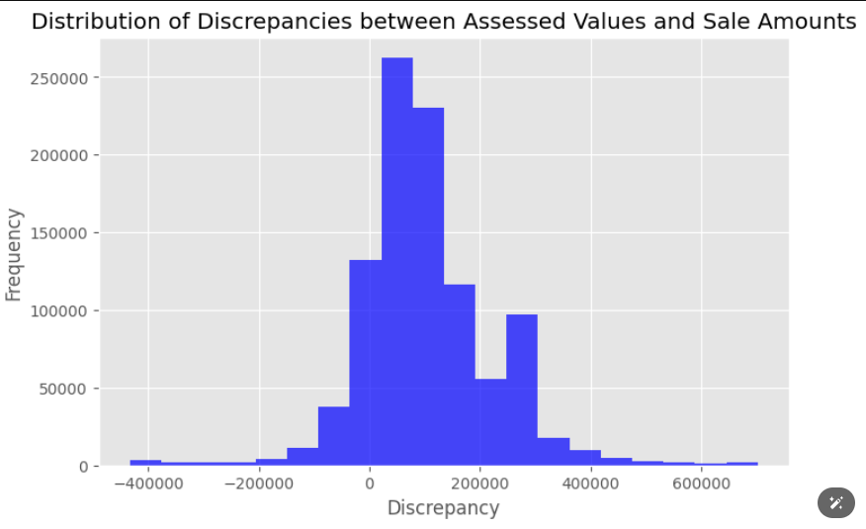
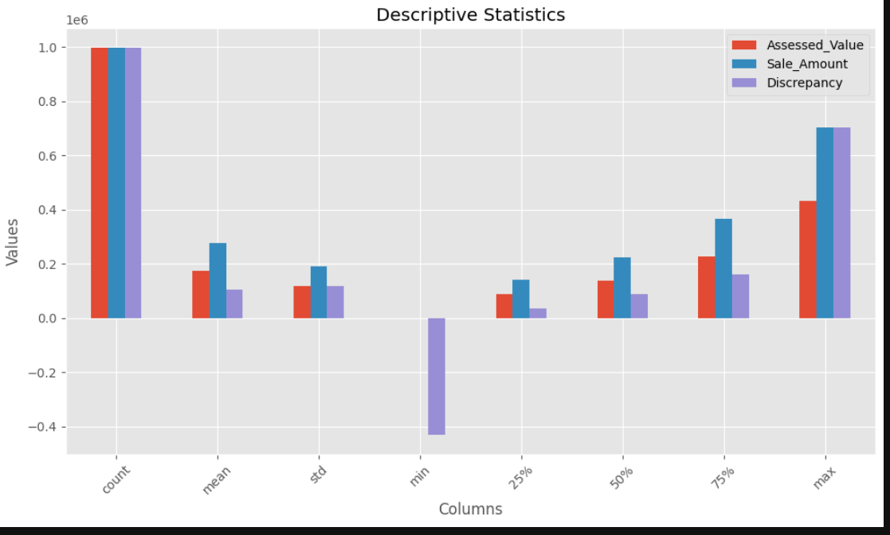
Assessment Accuracy:
There is high positive correlation between Assessed Value and Sales Amount.
There are fewer properties with discrepancies beyond this range, with a peak around 0 indicating a relatively common level of agreement between assessed and sale values.
The minimum value for Discrepancy is -432,500 indicating cases where the assessed value is higher than the sale amount.
It suggests that discrepancies of 0 to 200,000 are more frequent compared to larger discrepancies, with a decrease in frequency as the discrepancies become larger.
The mean Discrepancy between Assessed Value and Sale Amount is 103,862.

Slide 9
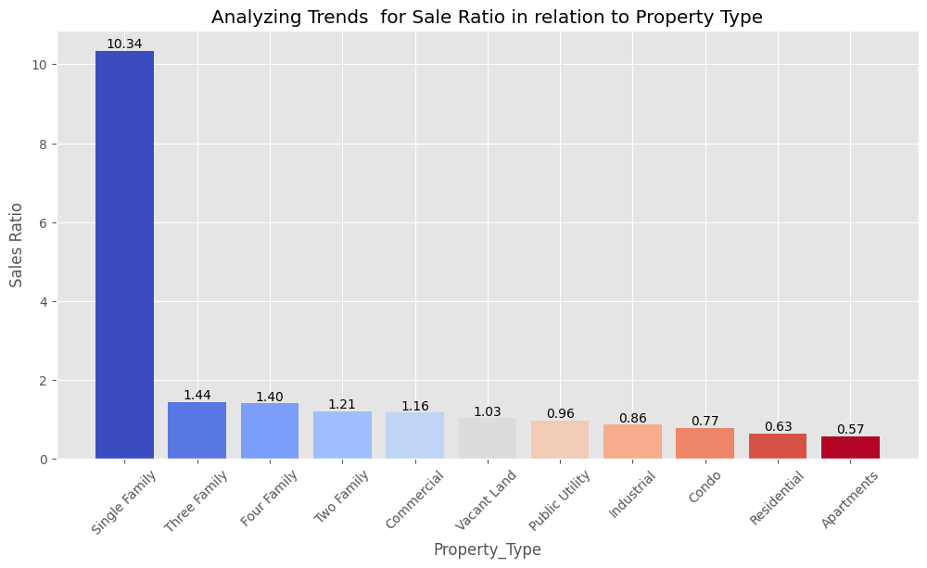
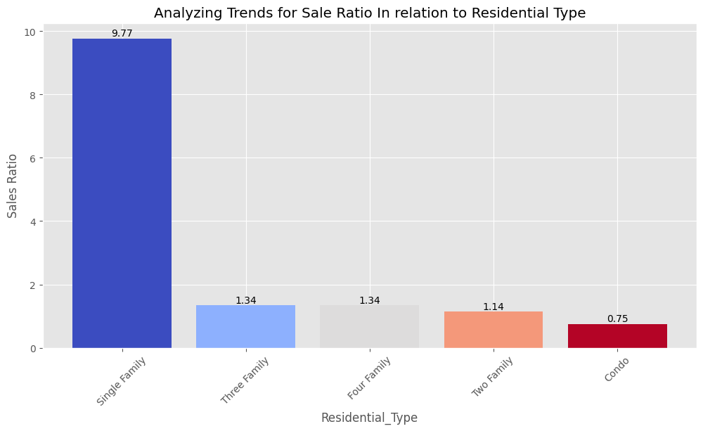
Market Trends:
On average, the assessed value of the property is 8 times greater than the price at which it was sold. This could indicate a potential discrepancy between assessed values and actual sale amounts.
Single-family property types and residential type has the highest sale ratio which means on average, the assessed value of Single Family homes are higher than their actual sale amounts, indicating strong demand or potentially overvalued properties in this category.
For other property types that are in the range of 0.57 to 0.96 implies a lower Sales ratio, which means the assessed value is slightly or significantly lower than their sales amount suggesting a more balanced market or potentially undervalued properties in these categories.
CONDO Residential type shows a Sales Ratio of 0.75, indicating the sale amounts are 75% of their assessed values, suggesting that Condos are selling below their assessed values potentially indicating a lower demand compared to other property types. This trend suggest challenges like pricing competitiveness, or valuation discrepancies.

Slide 10
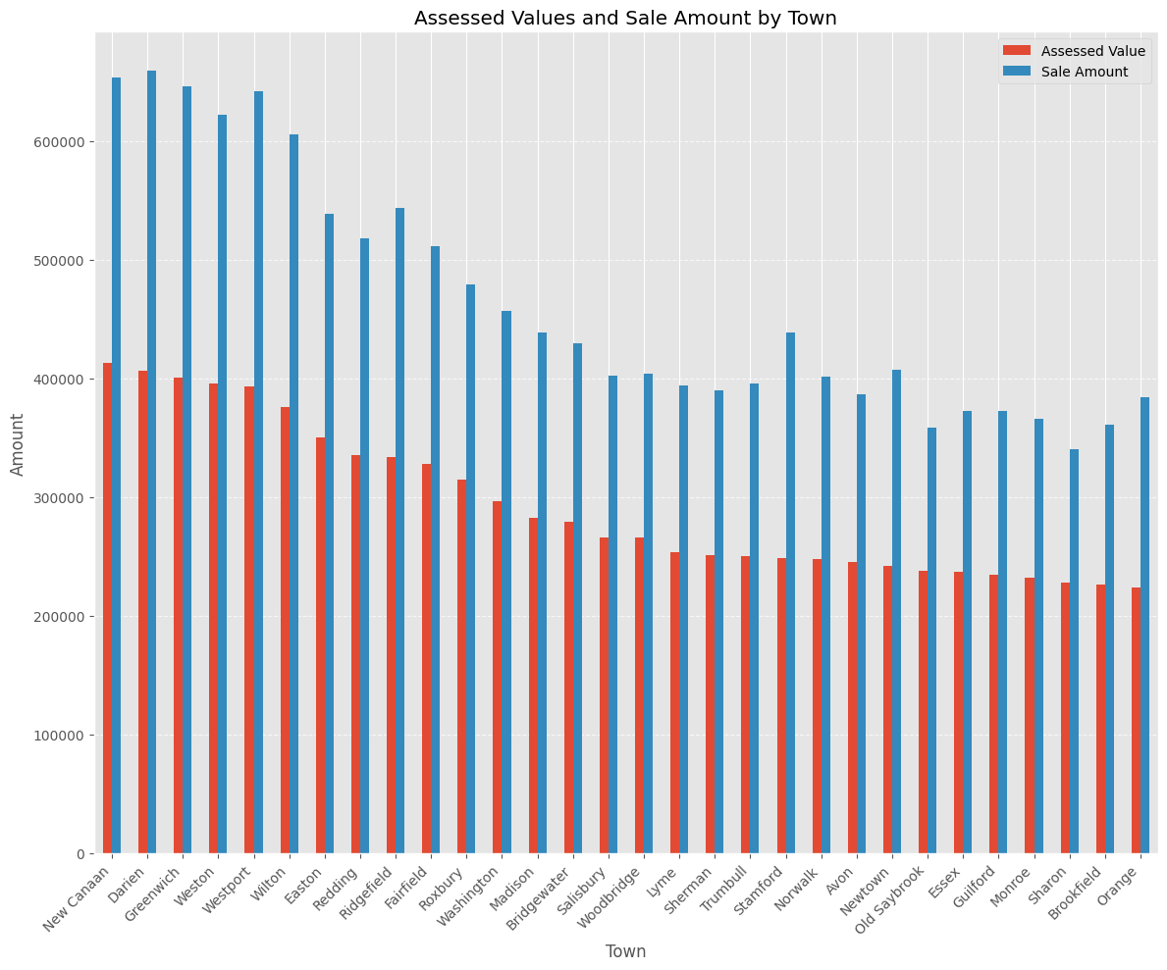
Geographical Analysis:
We have Bridgeport and Stamford having the highest count for most frequently occurring town.
New Canaan has the highest average Assessed value of 412,950 followed by Darien with an average assessed value of 406,199, then Greenwich with an average assessed value of 401,119.
The average sale amounts seem to vary across towns, with some towns like New Canaan and Darien having higher sale amounts compared to others.
Town | Assessed Value | Sale Amount
New Canaan | 412950 | 653336
Darien | 406199 | 659238
Greenwich | 401119 | 645795
Weston | 395591 | 621962
Westport | 392950 | 641729

Slide 11
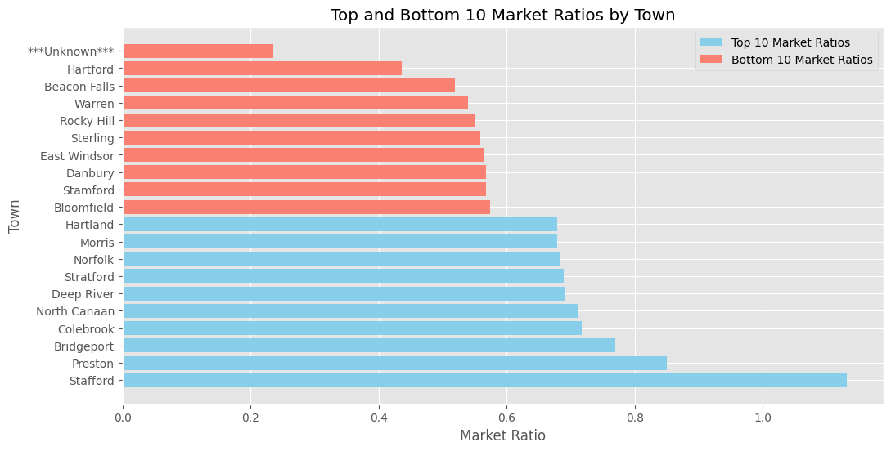
Geographical Analysis continuation…… :
Stafford has the highest market ratio indicating assessed values are slightly higher than sale amounts on average.
Preston has a market ratio of around 0.85, suggesting suggests that properties in Preston are selling below their assessed values on average.
While the Town registered with the name ***Unknown*** and Hartford have the lowest market ratio.
TOWN | MARKET RATIO
Stafford | 1.13
Preston | 0.85
Bridgeport | 0.77
Colebrook | 0.72

Slide 12
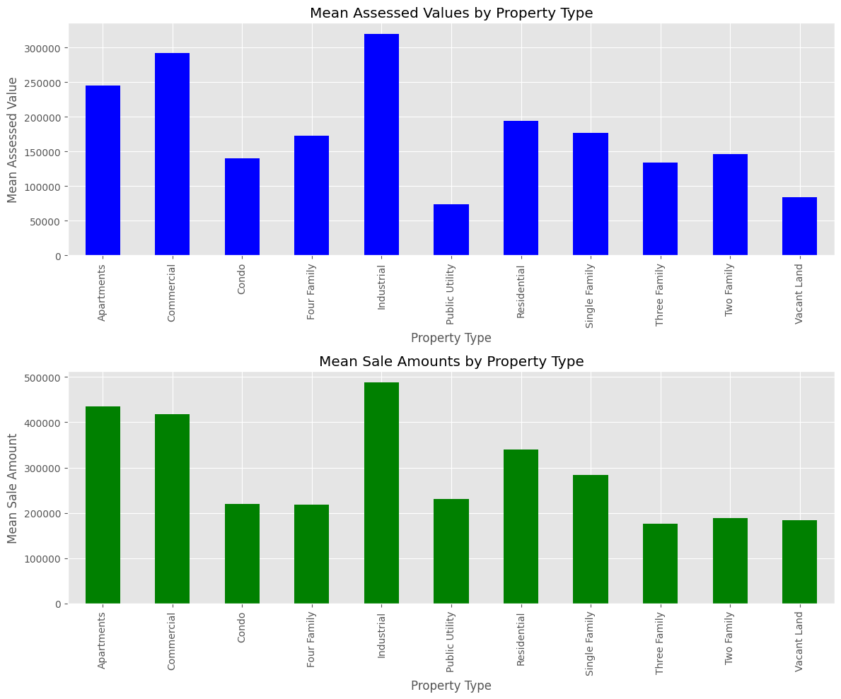
Property Type Impact:
Industrial Property type have the highest average (mean) of Assessment Value and Sale Amount which means they are valued and sold at higher amounts compared to other property types.
Public Utility Property type have the lowest average (mean) of Assessment Value and Three-Family property type have the lowest average(mean) of Sales Amount.
This indicates that Public Utility properties, on average, have the lowest assessed values among the mentioned property types. It suggests that Public Utility properties are valued lower compared to other property types.
Three-Family properties, on average, are sold at lower prices compared to other property types. It suggests that the sale prices for Three-Family properties are relatively lower on average.

Slide 13
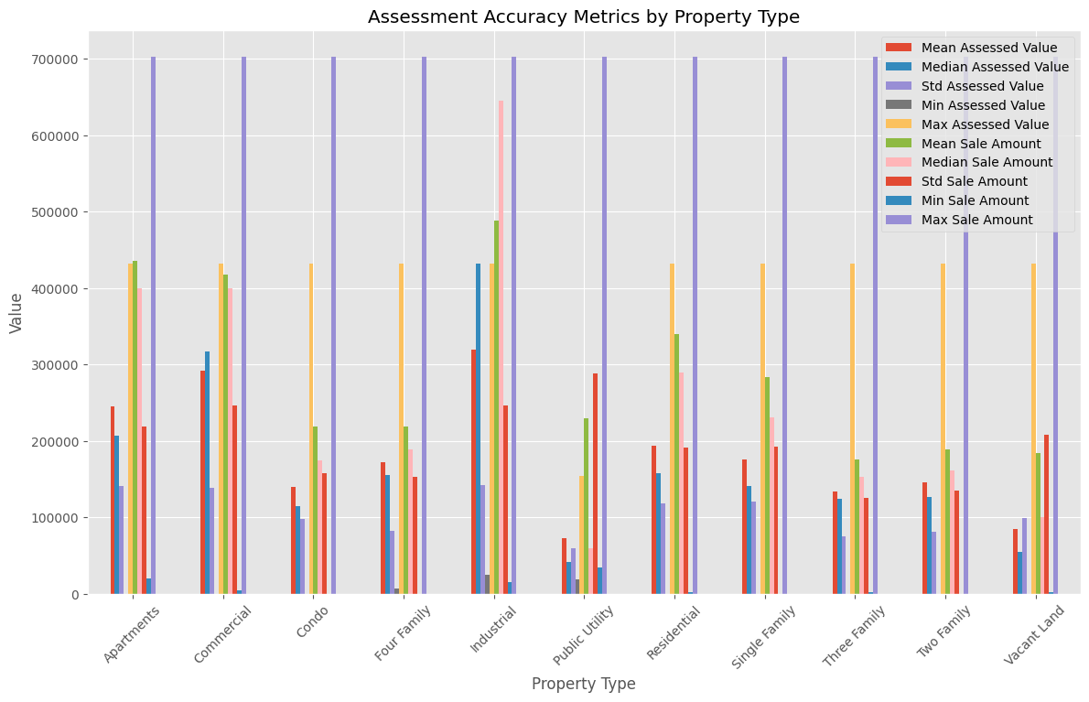
Property Type Impact:
Maximum assessed value for all property type have almost the same values of 432,500 expect Public Utility, and same goes for Sale amount as well with value of 702,500.
The consistent maximum values for both assessed value and sale amount across all property types may indicate a standardized valuation approach or pricing ceiling within the market.
A higher standard deviation indicates that sale amounts for properties within that category vary more widely from the average sale amount.

Slide 14
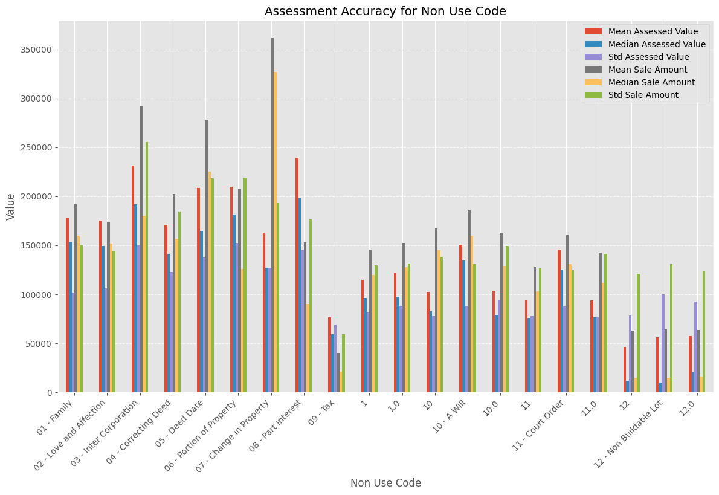
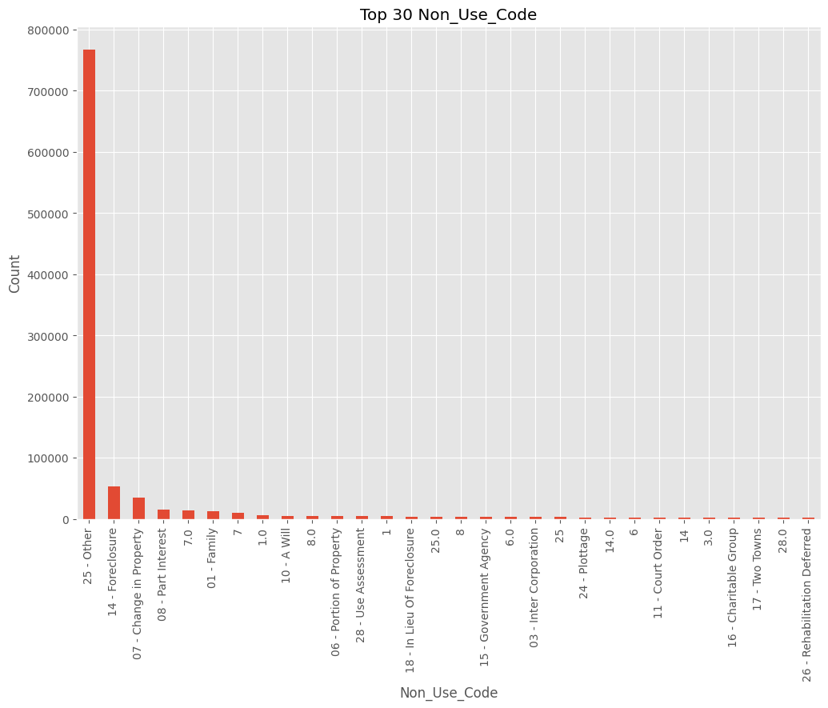
Non Use Code Insights:
25-Other has the highest value count followed by 14-Foreclosure and 07-change in Property.
Non-use codes highlight non-standard or atypical property transfers that may not follow traditional market dynamics. For example, transactions labeled with codes such as "Love and Affection" or "Correcting Deed" may involve unique circumstances that differ from typical market transactions.
The nature of the transaction indicated by non-use codes can influence the assessed value of the property.

Slide 15
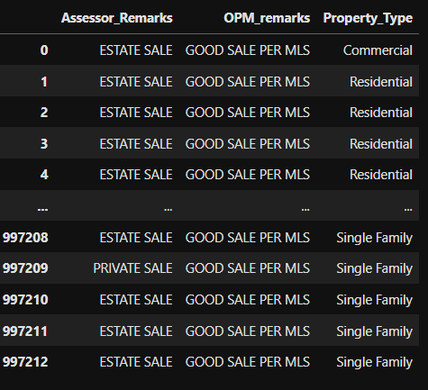
Assessor and OPM Remarks:
The dataset includes various Assessor Remarks such as "AS IS SALE," "AS IS SUBJECT TO PROBATE," "BROADCAST HOUSE," "work done on property prior to sale and after assmt date," and more.
The OPM Remarks in the dataset are described as "GOOD SALE PER MLS" for most of all entries.
OPM Remarks may signify that the property sale was considered good based on Multiple Listing Service (MLS) data
Each unique Assessor Remark likely signifies specific factors or events that influence the assessment process, such as property condition, legal considerations, or transaction details.

Slide 16
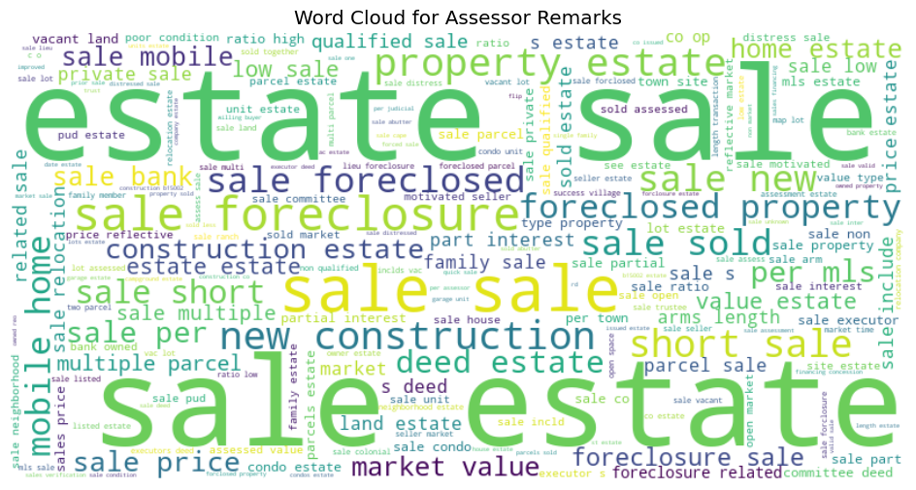
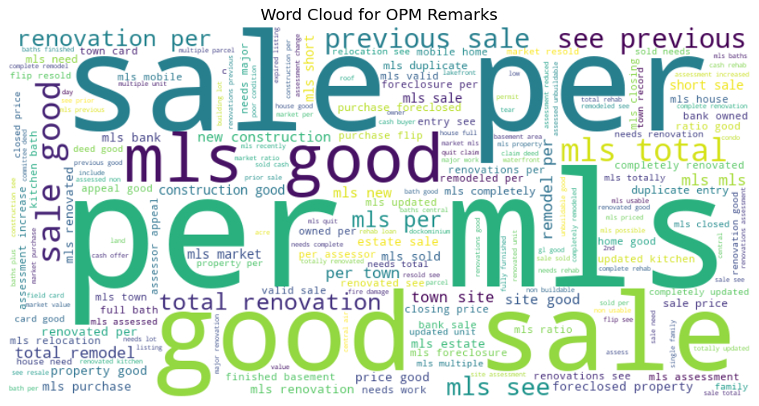
ASSESSOR REMARKS
OPM REMARKS

Slide 17
RECOMMENDATIONS
BASED ON FIRST OBJECTIVE:
Improve the accuracy of property assessments and ensure consistency between assessed values and actual sale amounts.
Quality Assurance: Implement measures to improve the accuracy and reliability of property assessments. This may include enhancing assessment procedures, conducting regular audits to identify and rectify discrepancies.
BASED ON SECOND OBJECTIVE:
Conduct a comprehensive analysis of the Condo market segment to understand the underlying factors contributing to the lower sales ratio.
Continuously monitor market trends, sales data, and feedback from potential buyers to adapt strategies in real-time.
Consider negotiating favorable deals and value-added strategies like redevelopment to maximize returns.
For Vacant Land, evaluate the potential for land development with thorough due diligence and feasibility studies.

Slide 18
RECOMMENDATIONS
BASED ON THIRD OBJECTIVE:
Conduct detailed market analysis in towns with lower average assessed values but higher sale amounts to understand the dynamics driving sales in those areas. There may be opportunities for growth or development.
Consider investing in real estate in towns like New Canaan, Darien, Greenwich, and Weston due to their higher average assessed values. These towns may offer good investment potential.
Conduct a thorough review of property valuation methods and practices in areas with low market ratios to ensure accuracy and fairness in assessments.
BASED ON FOURTH OBJECTIVE:
Implement regular reviews of property valuations based on updated market data and performance metrics.
Stakeholders should collaborate with real estate experts to identify and implement property type-specific valuation methodologies. This may involve considering factors such as location, size, condition, and use case of the property to ensure accurate assessments.

Slide 19
RECOMMENDATIONS
BASED ON FIFTH OBJECTIVE:
Implement regular reviews and validations of property assessments involving non-use codes to ensure consistency and accuracy.
Ensure thorough documentation and recording of non-use codes associated with property transactions. This includes accurately capturing the nature of the transaction and its purpose.
BASED ON SIXTH OBJECTIVE:
Recommend enhancing data collection processes to capture more detailed and standardized Assessor Remarks to improve the accuracy and depth of property assessments.
Recommend implementing a feedback mechanism to gather input from assessors and stakeholders on the effectiveness of utilizing Assessor Remarks in property assessments, enabling continuous improvement.

Slide 20
CONCLUSIONS
This EDA revealed insights into the factors influencing real estate sales, including property/residential characteristics and sale condition, Assessor and OPM remarks utilization and variations of assessments value and sales amount among different towns.
By reviewing the recommendations, stakeholders can enhance the accuracy and reliability of property assessments, reduce discrepancies between assessed values and sale amounts, and ultimately improve trust and confidence in the assessment process among all stakeholders involved.

Slide 21

Thank you

